Slide 1
Can LLM Already Serve as A Database Interface? A Big Bench for Large-Scale Database Grounded Text-to-SQLs
Team Name: Query Crafters
Bharath Somasundaram,
bs4852@nyu.edu
MS Computer Science
New York University
Praneeth Kumar Thummalapalli
pt2427@nyu.edu
MS Computer Science
New York University
Shreya Sudhakaran
ss18292@nyu.edu
MS Computer Science
New York University
Anukriti Singh
as18292@nyu.edu
MS Computer Science
New York University
Github Repo: https://github.com/bharathsomasundaram/big_data_project Github Repo: https://github.com/bharathsomasundaram/big_data_project

Slide 2

Agenda
Introduction
Model Architecture Overview
Demo
Results
Challenges
Conclusion
Future Work

Slide 3
Introduction
Performance testing of integrated system:
Six different approaches to feed the Large Language Model (LLM)
Comparison of results using components crucial for accuracy and relevance:
Hints
Schema
Shots
Objective:
Develop methodologies to enhance translational accuracy
Ensure scalability and generalizability across diverse database environments
Push the boundaries of semantic parsing and database querying with LLMs

Slide 4
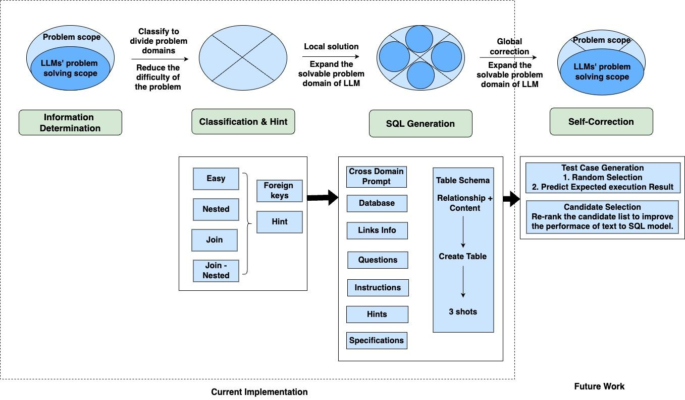
Model Architecture: Overview

Slide 5
DEMO

Slide 6
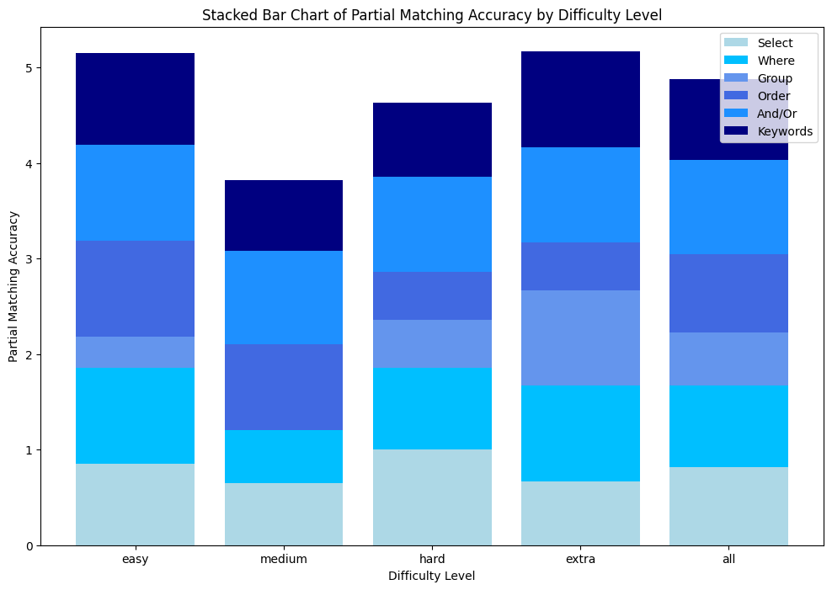
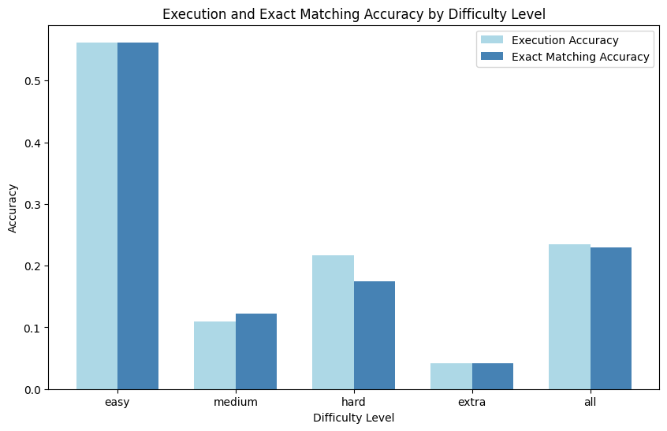
Results - Scenario - I: Generated by using shots, hint and schema

Slide 7
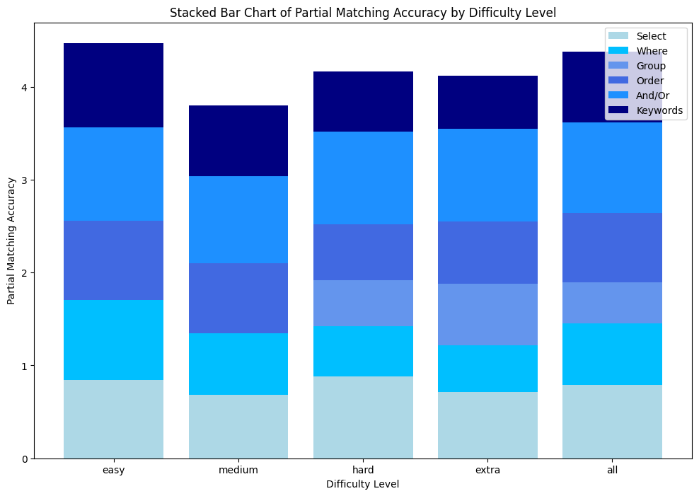
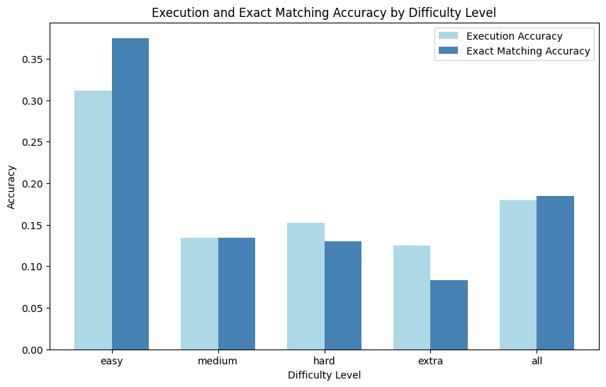
Results - Scenario - 2: Generated by using hints and schema without any shots

Slide 8
Results - Scenario - 3: Generated by using shots, hints and short schema

Slide 9
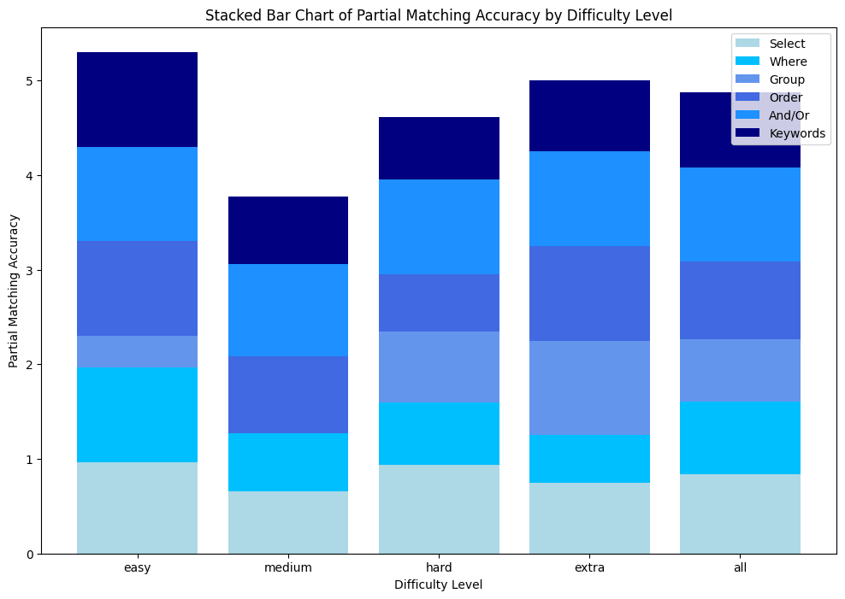
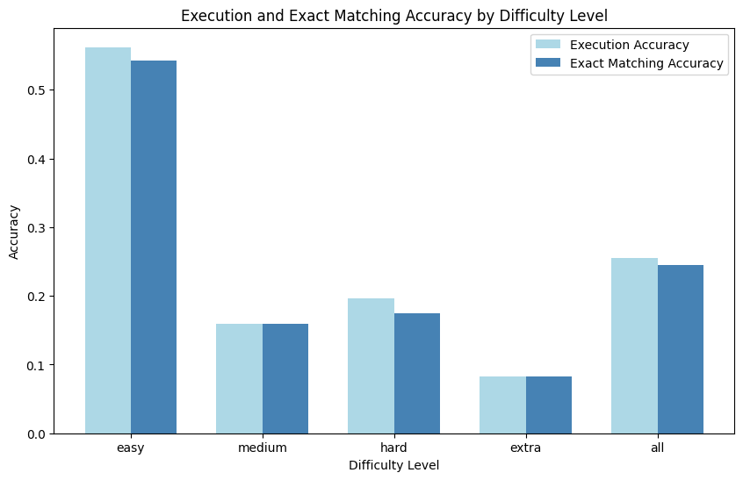
Results - Scenario - 4: Generated by using hints and short schema without any shots

Slide 10
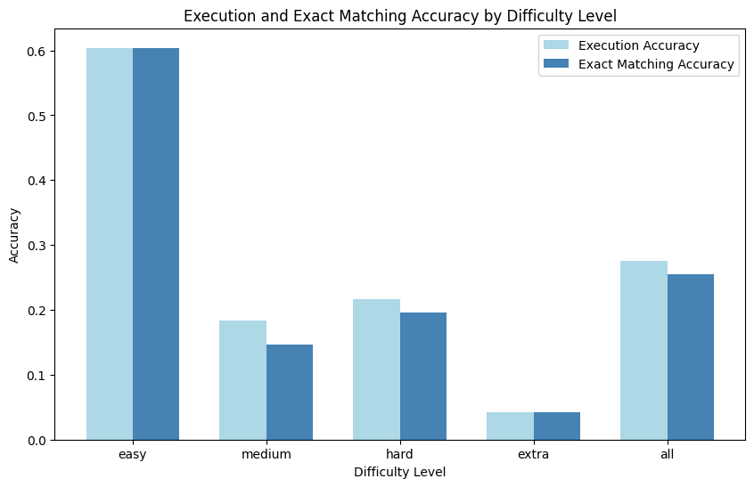
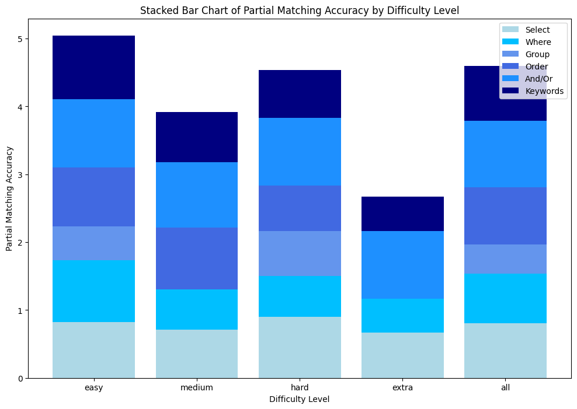
Results - Scenario - 5: Generated by using shots and schema without any hints

Slide 11
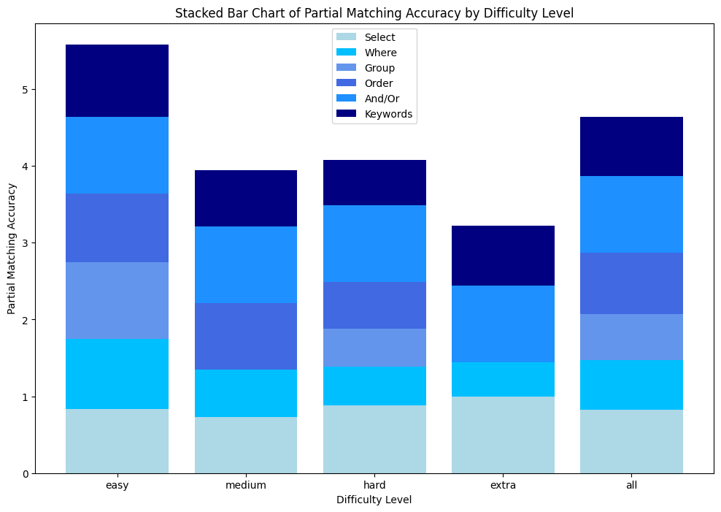
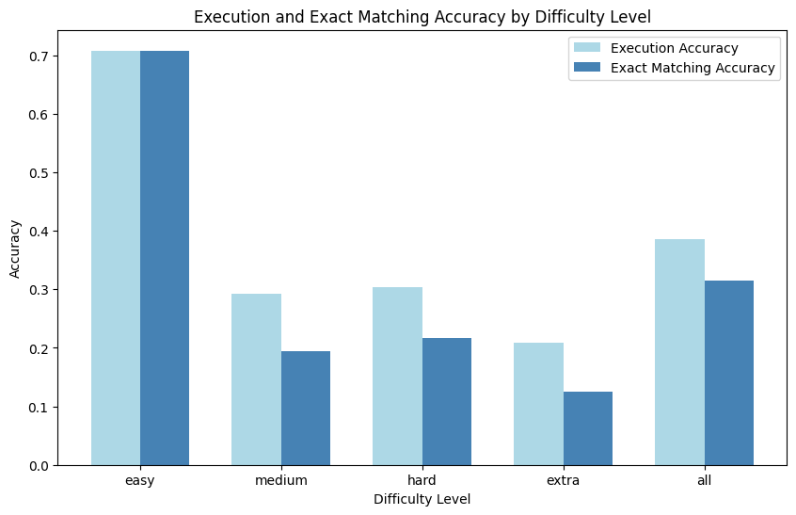
Results - Scenario - 6: Generated using GPT-4 pipeline

Slide 12
Challenges
Rate limits of GPT models
Expenses
Hindrance of generalization
Quality of shots

Slide 13
Conclusion
Evaluation methodology:
Comparison against standard results from the Spider dataset
Comparison against outcomes derived from GPT-4.0 standalone usage
Performance metrics:
Execution accuracy of integrated pipeline: 60.4%
Execution accuracy of GPT-4.0 standalone: 70.8%
Implications of findings:
Integrated approach introduces complexity and potential robustness
GPT-4.0 standalone demonstrates superior accuracy in text-to-SQL query generation under test conditions

Slide 14
Future Work
Diverse candidate queries:
Queries tailored to capture nuances of instructions and database schema
Varied query structures and conditions to test adaptability
Incorporation of complex joins and subqueries to assess advanced comprehension
Optimization of test case generation and evaluation:
Comprehensive coverage of potential scenarios
Ensuring effectiveness in assessing query performance
Integration of edge cases and boundary scenarios for robust evaluation
Implementation of feedback loop mechanism:
Continuous improvement through user feedback incorporation
Error correction mechanism for enhancing translation accuracy
Monitoring and adjustment based on system performance metrics

Slide 15
Thank You!

